Slide 1

Teams Data Requests User Manual
Access the portal through https://bit.ly/TheNewDataOps
Works best on a PC; limited functionality on mobile.

Slide 2

Click on Data Requests.
Click on Teams Data Requests.
You will be directed to a portal that asks for your login credentials.

Slide 3
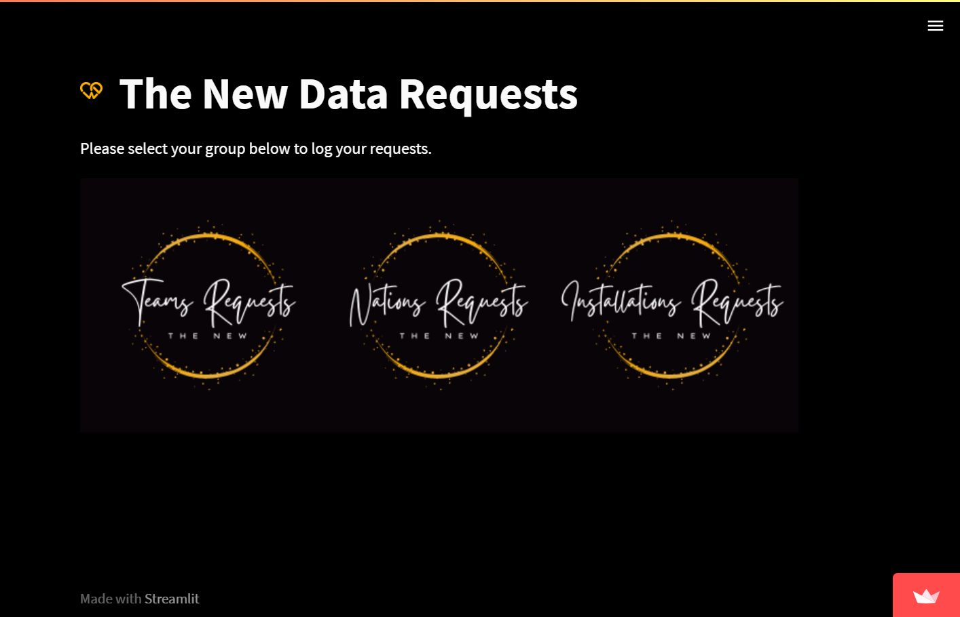
Click on Data Requests.
Click on Teams Data Requests.
You will be directed to a portal that asks for your login credentials.

Slide 4
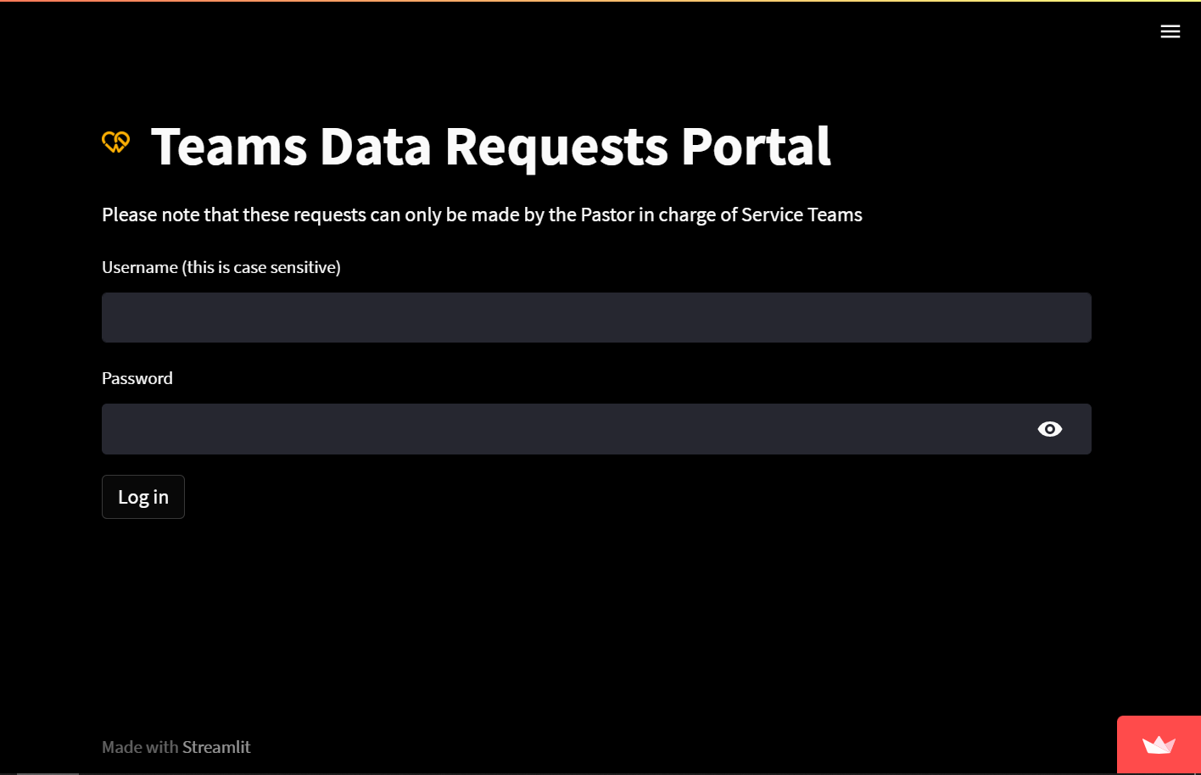
Click on Data Requests.
Click on Teams Data Requests.
You will be directed to a portal that asks for your login credentials.

Slide 5
Add to workforce / Modify existing workforce

Slide 6
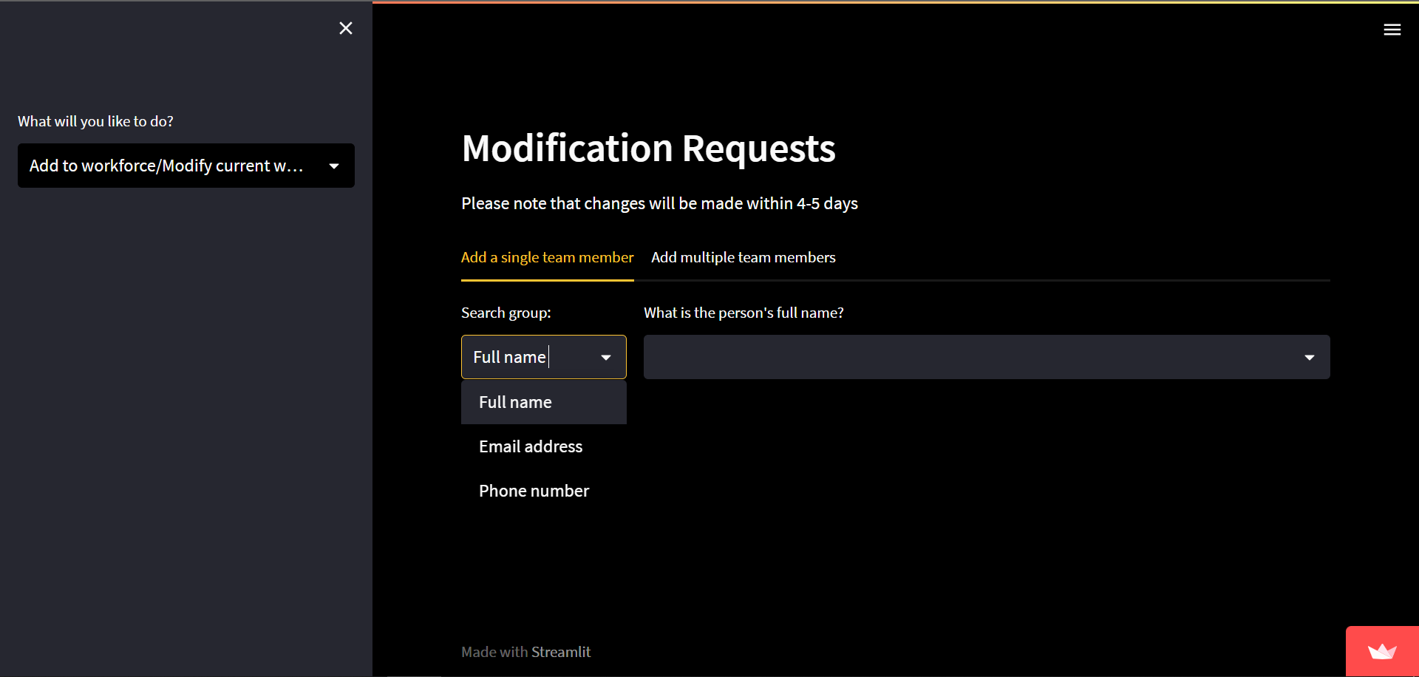
You can either add/modify a single person or multiple people
In the add a single team member tab, you can search for the person by name, email, or phone number.
Tab Options:
Add to workforce/ Modify…
Search for person and select
Search by

Slide 7
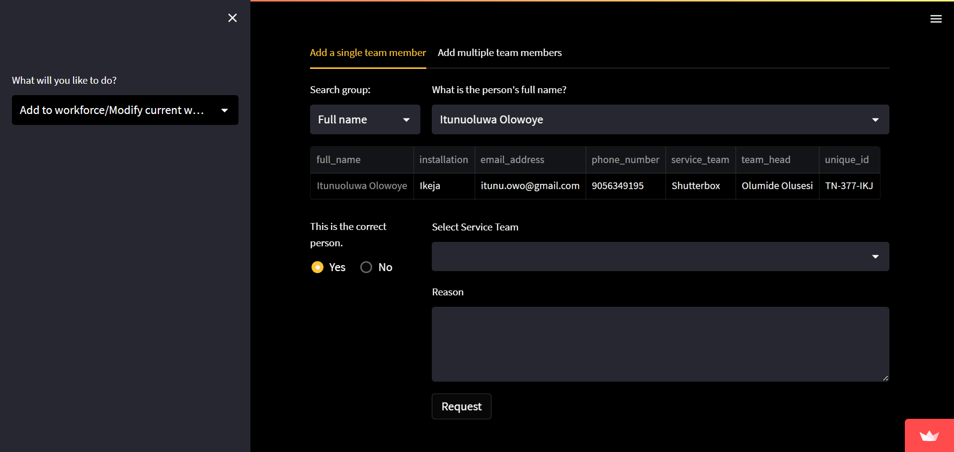
When the person’s record is found and confirmed accurate, select the person’s new service team.
Also write the reason for addition/modification (optional, but preferable).
Click on Request. You should get a confirmatory email for follow up.
Tab Options:
Add to workforce/ Modify…
Person’s details
Select new service team and state the reason for addition (optional, but preferable)
Is the record correct?
Log request

Slide 8
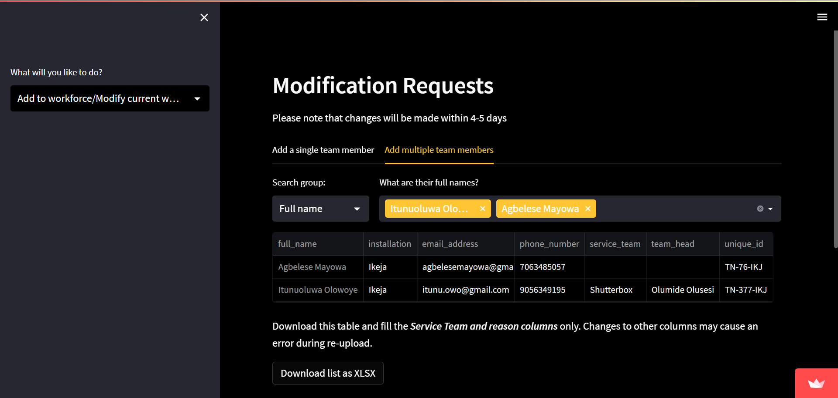
In the add multiple team members tab, you can search for the people by name, email, or phone number.
When the records are found and confirmed accurate, download the records.
Fill only the service team and reason columns.
The reason for addition/modification is optional, but preferable.
Tab Options:
Add to workforce/ Modify…
People’s details
Download file

Slide 9
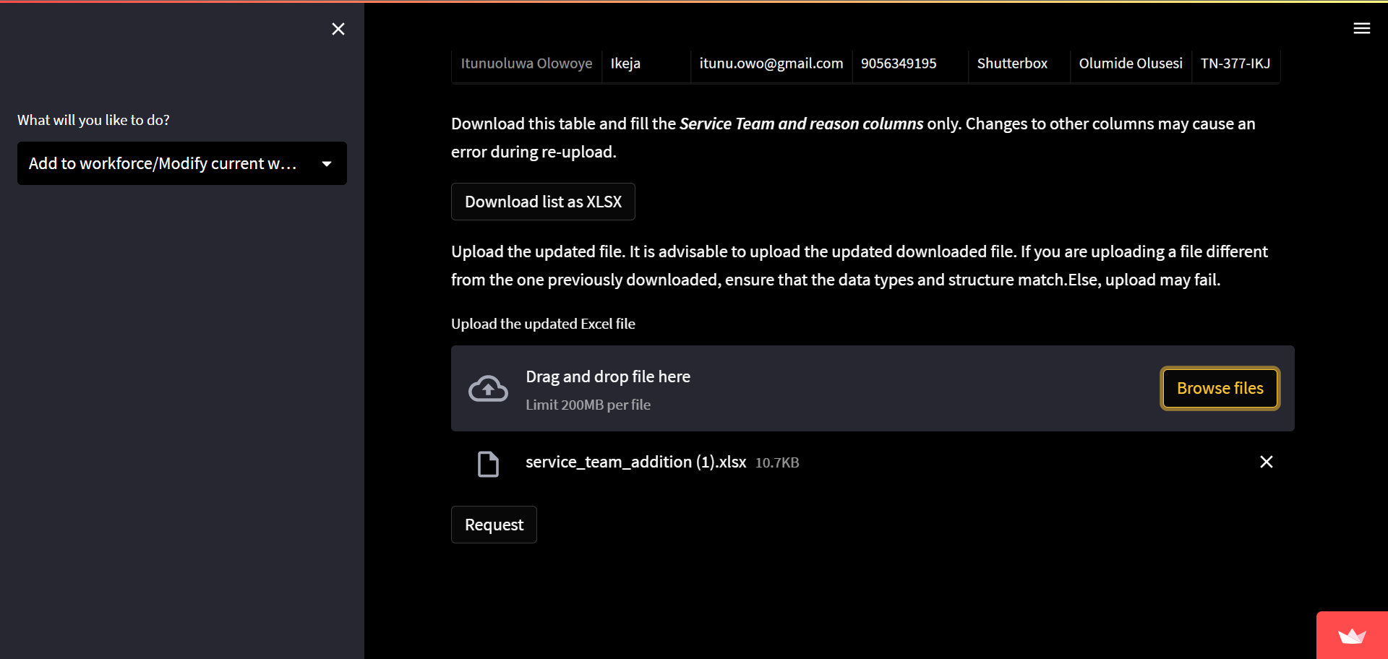
Upload the updated downloaded file.
Send in the request.
You should receive a confirmatory email for follow up
Tab Options:
Add to workforce/ Modify…
Send the request
Upload updated downloaded file

Slide 10
Remove from workforce

Slide 11

You can either remove a single person or multiple people
In the remove a single team member tab, you can search for the person by name, email, or phone number.
Tab Options:
Remove from workforce
Search for person and select
Search by

Slide 12
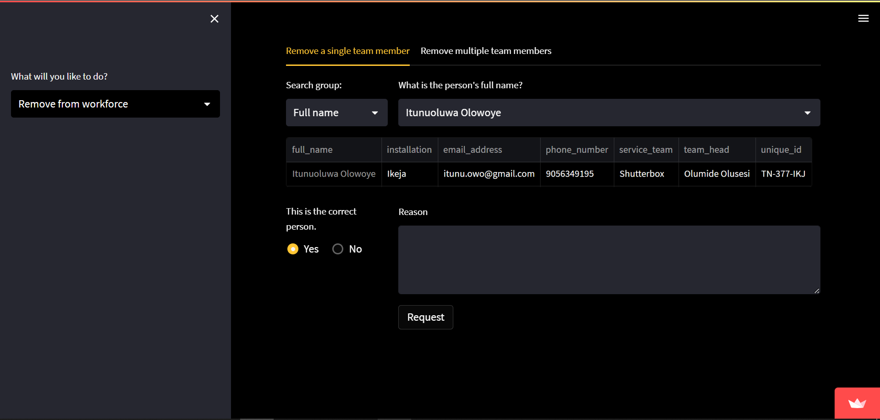
In the remove a single team member tab, you can search for the person by name, email, or phone number.
When the person’s record is found and confirmed accurate, state the reason for removal (optional, but preferable).
Click on Request. You should get a confirmatory email for follow up.
Tab Options:
Remove from workforce
Person’s details
Is the record correct?
State the reason for addition (optional, but preferable)
Log request

Slide 13
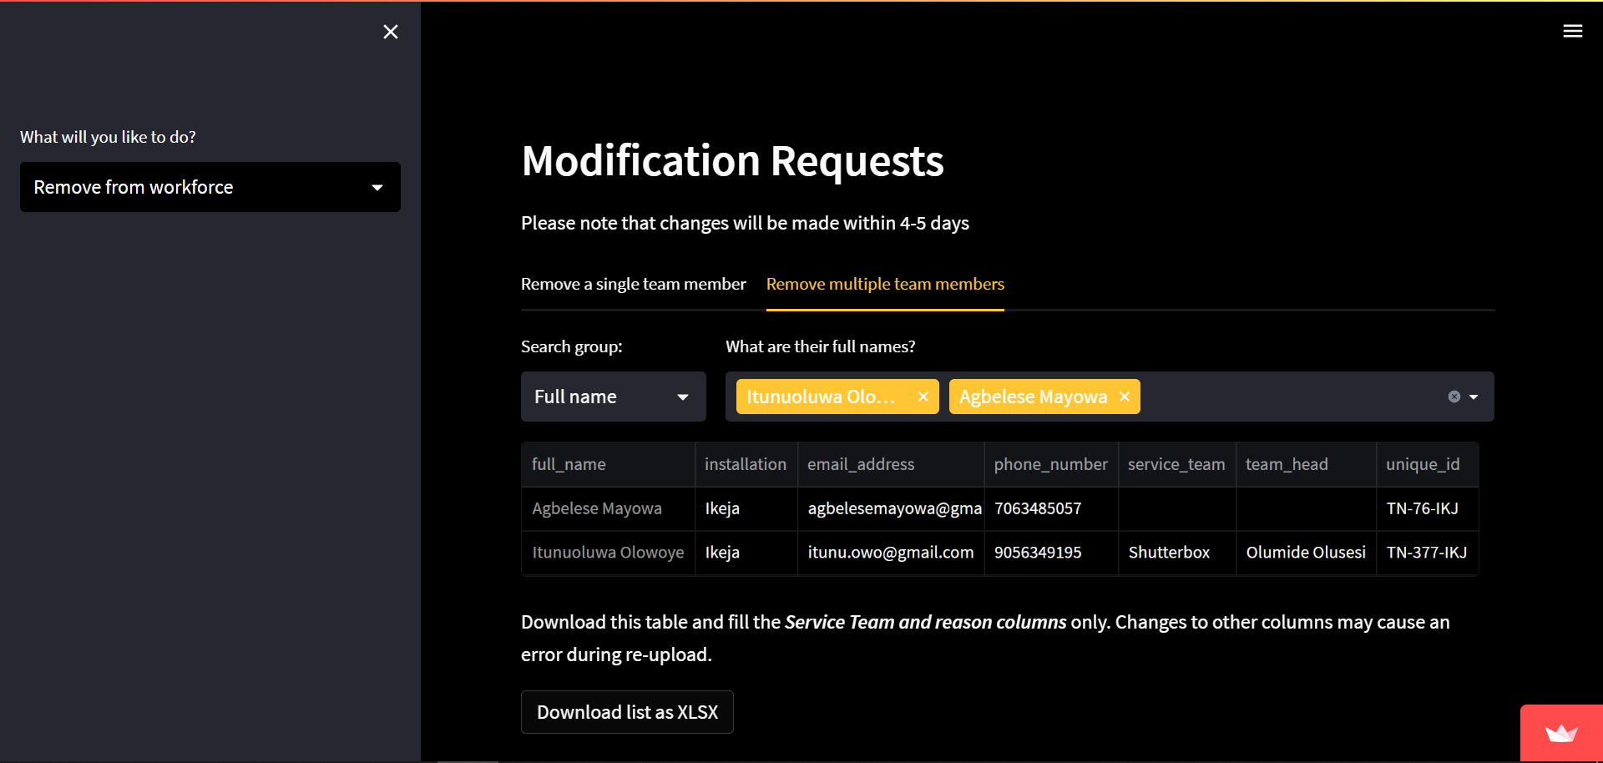
In the remove multiple team members tab, you can search for the people by name, email, or phone number.
When the records are found and confirmed accurate, download the records.
Fill the reason column. Clearing out the service team column is optional.
The reason for removal is optional, but preferable.
Tab Options:
Remove from workforce
People’s details
Download file

Slide 14
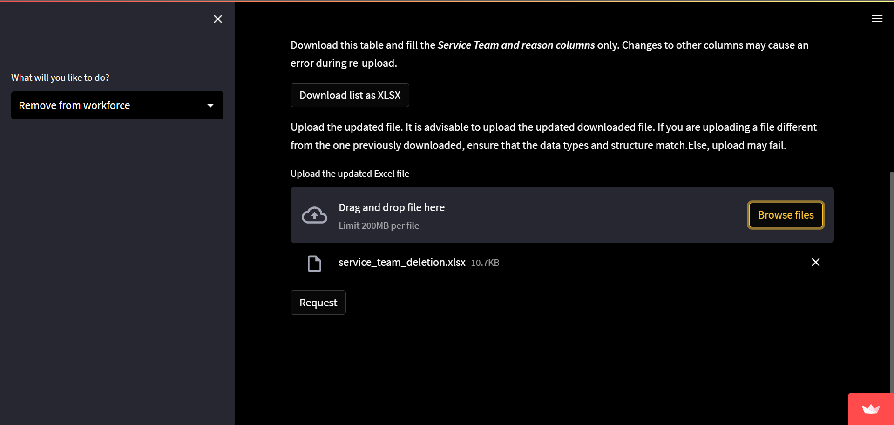
Upload the updated downloaded file.
Send in the request.
You should receive a confirmatory email for follow up
Tab Options:
Remove from workforce
Send the request
Upload updated downloaded file

Slide 15
Change service team head

Slide 16
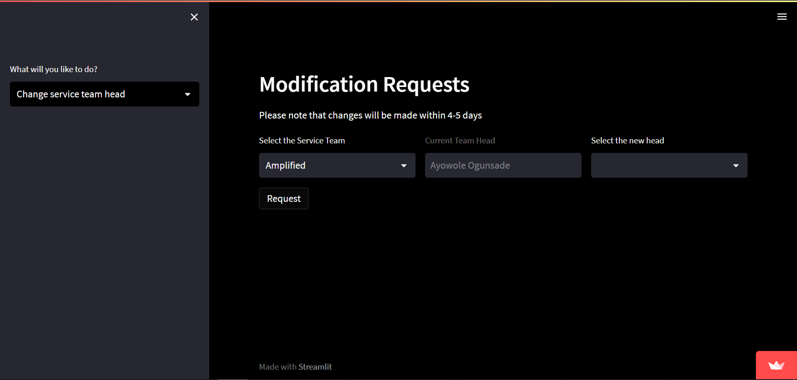
In the case of a handover, you can simply select the service team and select the new team head.
Click on Request to log your entry.
You should get a confirmation email for follow up.
Tab Options:
Change service team head
Select service team
Send the request
Select new team head

Slide 17
Thank You

